Slide 1
Definition: Object-Oriented Programming (OOP) is a programming paradigm based on the concept of objects, which can contain data and code to manipulate that data.
Core Concepts:
Classes and Objects
Inheritance
Encapsulation
Polymorphism
Benefits:
Modularity
Reusability
Scalability
Introduction to OOP

Slide 2
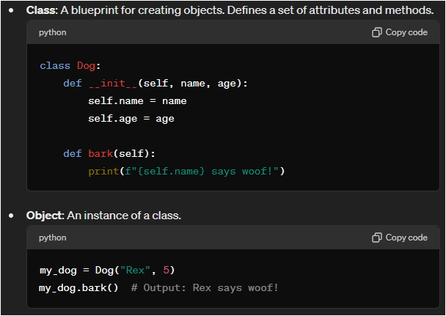
Classes and Objects

Slide 3
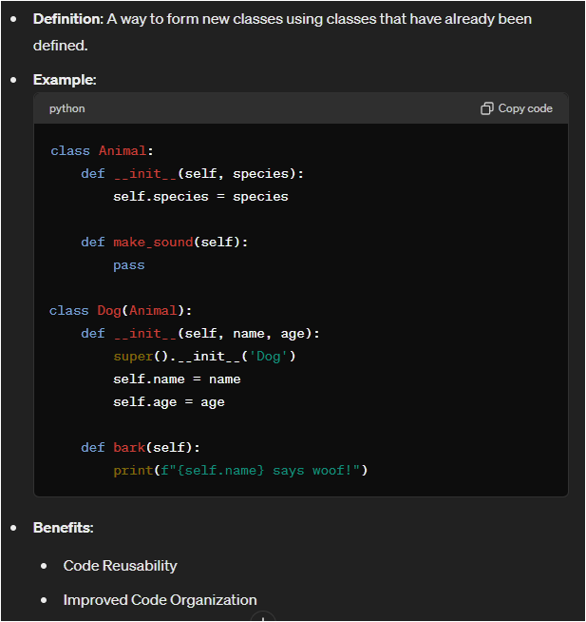
Inheritance

Slide 4
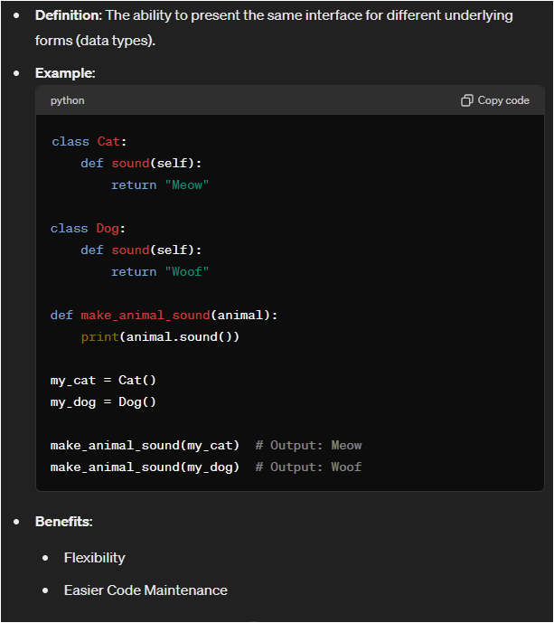
Polymorphism

Slide 5
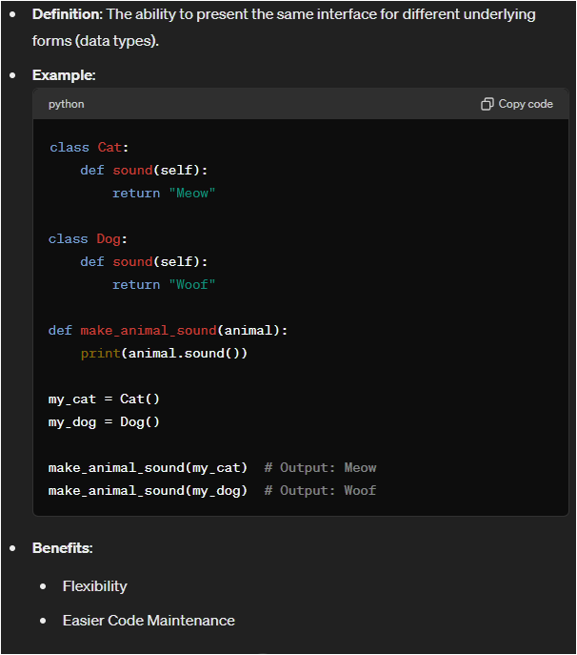
Polymorphism

Slide 6
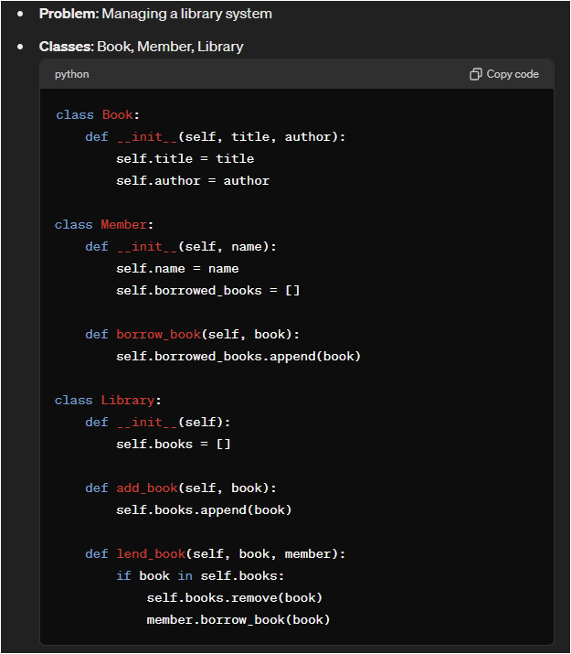
Real-World Example

Slide 7
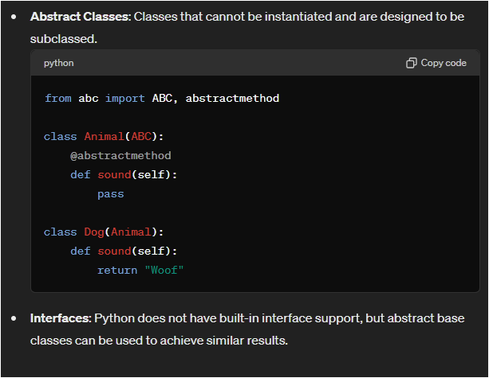
Advanced OOP Concepts

Slide 8
Summary
OOP Principles: Encapsulation, Inheritance, Polymorphism
Benefits: Modularity, Reusability, Scalability
Python Features: Easy to implement OOP concepts, supports advanced OOP features like abstract classes.

Slide 9
Q&A
Questions:
Open the floor for any questions about OOP in Python.

Slide 10
Thank you for your time
Best Regards with
Eng/Kirollos Gerges

